Slide 1
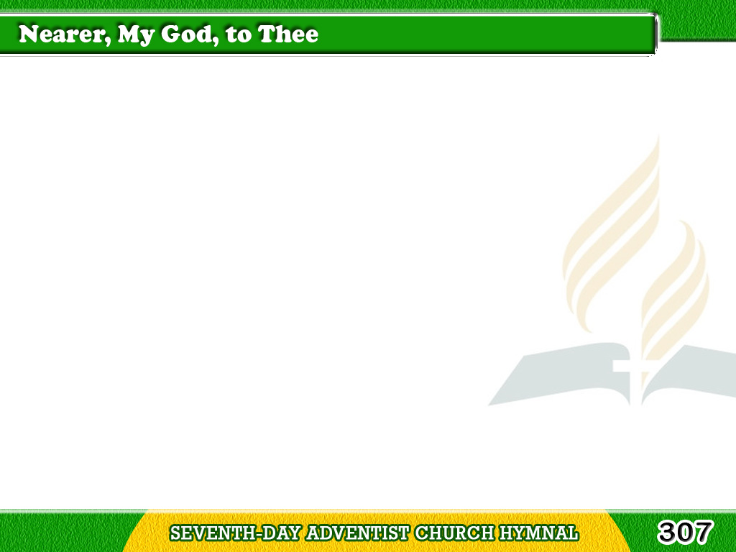
1/5
Nearer, my God, to Thee,
Nearer to Thee!
E’en though it be a cross
That raiseth me!
Tagalog
Version

Slide 2
1/5
Still all my song shall be,
Nearer, my God, to Thee,
Nearer, my God, to Thee,
Nearer to Thee,
Tagalog
Version

Slide 3
2/5
Though like a wanderer,
Daylight all gone,
Darkness be over me,
My rest a stone;
Tagalog
Version

Slide 4
2/5
Yet in my dreams I’d be
Nearer, my God, to Thee,
Nearer, my God, to Thee,
Nearer to Thee,
Tagalog
Version

Slide 5
3/5
There let the way appear,
Steps up to heaven;
All that Thou sendest me,
In mercy given;
Tagalog
Version

Slide 6
3/5
Angels to beckon me
Nearer, my God, to thee,
Nearer, my God, to Thee,
Nearer to Thee.
Tagalog
Version

Slide 7
4/5
Then, with my waking thoughts
Bright with Thy praise,
Out of my stony griefs
Bethel I’ll raise;
Tagalog
Version

Slide 8
4/5
So by my woes to be
Nearer, my God, to Thee,
Nearer, my God, to Thee,
Nearer to Thee.
Tagalog
Version

Slide 9
5/5
Or if, on joyful wing
Cleaving the sky,
Sun, moon, and stars forgot,
Upward I fly,
Tagalog
Version

Slide 10
5/5
Still all my song shall be,
Nearer, my God, to Thee,
Nearer, my God, to Thee,
Nearer to Thee.
Tagalog
Version

